Slide 1
Digital Portfolio
STUDENT NAME: Jagadeeswaran c
REGISTER NO AND NMID: 2428D0025&24csa26
DEPARTMENT: B.Sc Computer Science & Applications
COLLEGE: VET Institute Of Arts And Science (co-education)College Erode/ Bharathiyar UNIVERSITY

Slide 2
PROJECT TITLE
My Portfolio

Slide 3


AGENDA
Problem Statement
Project Overview
End Users
Tools and Technologies
Portfolio design and Layout
Features and Functionality
Results and Screenshots
Conclusion
Github Link
3/21/2024 Annual Review

Slide 4

PROBLEM STATEMENT
I realized that just having a resume isn’t enough anymore. Recruiters, faculty, and even peers often want to quickly see what someone can actually do. The problem for me was simple: I needed an online space that could showcase my skills, internships, and achievements in a neat, professional, and mobile-friendly way. I also wanted it to be easy to navigate and interactive, even without a backend system at the start.

Slide 5

PROJECT OVERVIEW
To solve that, I built a single-page portfolio website using HTML, CSS, and JavaScript. It’s designed to be clean, responsive, and visually appealing. The website has different sections like Profile, About Me, My Works, Skills, Proficiency, and Contact. Each section highlights a different part of my journey—whether it’s internships, technical strengths, or personal interests. I used animations and design elements to make it engaging without overloading the user.

Slide 6

WHO ARE THE END USERS?
The site is mainly for Recruiters/HR who want a quick snapshot of my skills Faculty/Mentors
who track my learning progress Peers/Collaborators who may want to connect or team up.
Hackathon Judges who need to evaluate skills quickly In short, anyone who wants to know what I can do, in a few minutes.

Slide 7

TOOLS AND TECHNIQUES
I kept it simple but effective:HTML5 for structure.CSS3 for styling, responsive layouts, and cool effects.
JavaScript for interactivity like slideshows and animated skill bars.
GitHub to version control and share my project online.
The goal was to use tools that are lightweight, reliable, and recruiter-friendly.

Slide 8
POTFOLIO DESIGN AND LAYOUT
I went with a dark theme (black background with red and blue highlights) because it feels modern and professional. The navigation bar sticks to the top so users can move around easily. The profile section has my picture along with rotating titles like “Web Developer” and “Data Analyst.” My works are displayed as neat cards, my skills are colorful clickable tags, and my proficiency is shown with animated progress bars. Everything is responsive, so it looks good even on a mobile screen.
8

Slide 9
FEATURES AND FUNCTIONALITY
Some of the key highlights are:
Auto-rotating profile titles.
A sticky header with links that highlight as you scroll.
Smooth animated skill bars.
Internship/project cards with details.
A contact form that looks real but currently simulates sending messages.
Fully responsive design.
All of these make the portfolio interactive and easy to use.

Slide 10
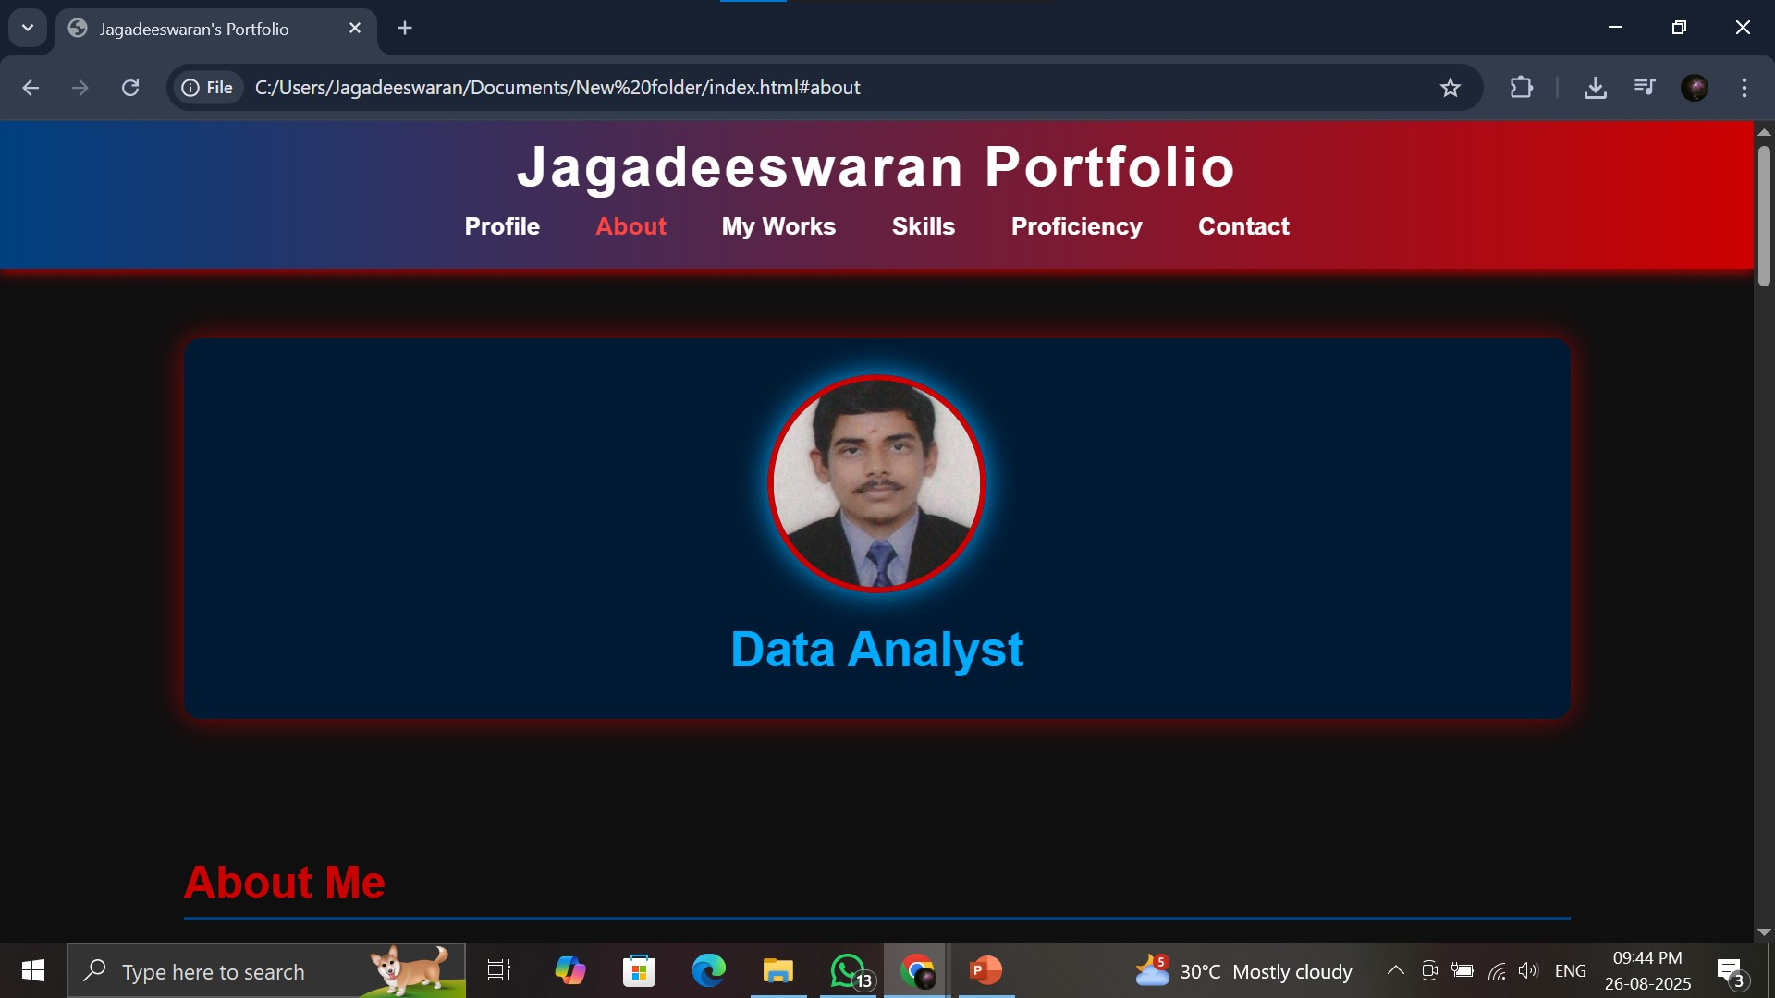

RESULTS AND SCREENSHOTS
3/21/2024 Annual Review
10

Slide 11
CONCLUSION
This project gave me a professional online identity that goes beyond a simple resume. It shows my coding, design, and problem-solving abilities in one place. The portfolio is a solid base, but I plan to make it even better by connecting the contact form to a backend service, adding more project showcases, and improving accessibility and SEO.
Git-hub Link:https://github.com/jagadees-vet
11

